Slide 1


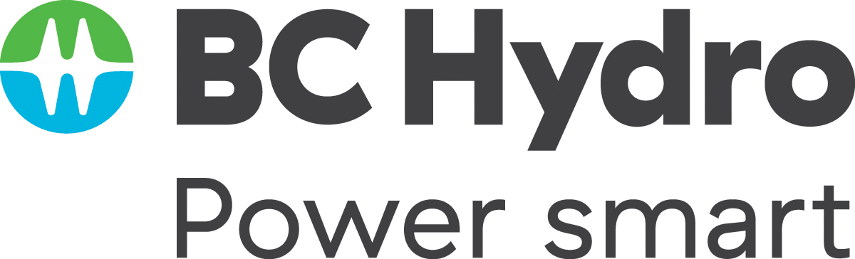
Twice as nice?
A Longitudinal Field Study of Separate vs. Combined Nudges for Household Laundry Behaviours
Notes:
Presentation given from Coast Salish lands

Slide 2
Co-Authors & Partners
UBC
David Hardisty
Kirstin Appelt
Sid Mookerjee
Yanwen Wang
Jiaying Zhao
BC Hydro
Arien Korteland
Valerie Rodrigues
Netu Sidhu

Slide 3
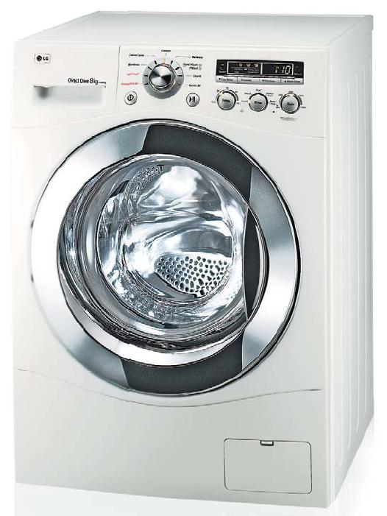
Context
Laundry represents 10% - 28% of home energy use
Little research on changing laundry behaviour
Identifiable via spikes in metered data (in theory)
“Case study” to test nudges
Notes:
Laundry energy calculation from BC Hydro calculations based on data from https://www.energystar.gov/
More precisely, laundry represents 10-12% of household electricity in homes using natural gas water heating, 19% - 28% in homes using electric water heating
Image from: https://upload.wikimedia.org/wikipedia/commons/0/08/LGwashingmachine.jpg

Slide 4
Key Questions
How to nudge sustainable behaviour change?
Better to use “pro-environment” motivation, “self-benefit” motivation, or both together?
Better to request many behaviour changes, or focus on one?

Slide 5
Pilot Surveys
Perhaps a decal on the laundry machine could provide a lasting nudge?
  Constant reminder
  Attractive
  Low-cost
  What‘s the right message?
6 pilot surveys (Feb 2021 – Apr 2021) pre-tested ideas via hypothetical scenarios with online samples from Prolific.co
  Financial appeals were not effective (e.g., “Change your laundry habits to reduce your costs by $2,129 over 10 years!”)
  Climate appeals were not effective (e.g., “Change your laundry habits to reduce your CO2 by 95,287 grams over 10 years!”)

Slide 6
Methods

Slide 7
Study Design: Participants
1,210 BC Hydro customers recruited from BC Hydro’s Team Power Smart program and completed the first survey
Follow-up surveys every 3 months, for 1 year total
Must have Washing Machine & Clothes Dryer and pay BC Hydro bill
64% women, mean age = 57
Notes:
Note: 1,647 agreed to participate in advance, but only 1,158 completed the time 1 survey, mostly due to blocked emails from Microsoft-related email addresses (such as @hotmail, @outlook, @msn, and @live email addresses) blocking our emails.

Slide 8
Target Laundry Behaviours
Re-wear
Combine loads
Use cold water
Hang dry clothes

Slide 9
Study Design: Overview
Six intervention conditions:
  Control (no decal)
  Control (QR logging decal)
  Decal: Turtle appeal to change 4 behaviours
  Decal: Fleece appeal to change 4 behaviours
  Decal: Turtle + fleece appeal to change 4 behaviours
  Decal: Turtle + fleece appeal to hang dry
Four types of measures:
  Intentions to re-wear, combine loads, cold water, hang-dry
  Retrospective self-reports every 3 months
  Ongoing log of laundry behaviour for one year
  Energy meter data (hourly level) for one year, including 1-year prior history

Slide 10
Control (no decal)

Slide 11
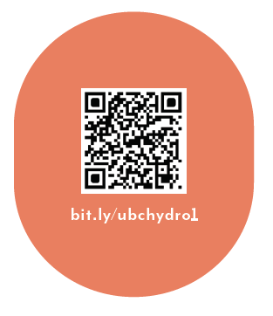
Control (logging decal only)
As part of your participation in this study, we will mail you a decal to put on your washer or dryer, which will look like the following:

Slide 12
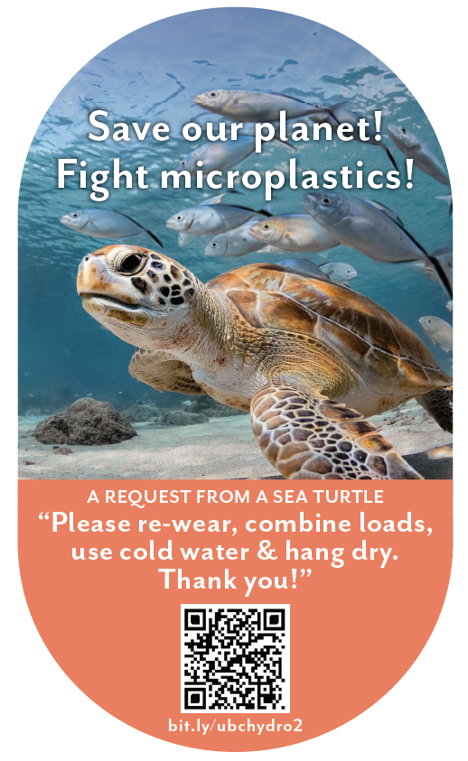
Sea Turtle + Bundled
When you machine wash and dry your clothes with hot water and hot air, “microplastics” come out of your clothes. In fact, experts say that between 700,000 and 12 million microfibres can be shed during one single load of laundry. It is estimated that laundry is responsible for 35% of microplastics in our oceans, seriously harming sea turtles and other marine life.
You can save our planet by:
- Re-wearing clothes more often
- Combining loads to run fewer, larger loads of laundry
- Washing laundry with cold water, rather than hot water or warm water
- Hanging clothes to dry (inside or outside), rather than machine-drying clothes
As part of your participation in this study, we will mail you a decal to put on your washer or dryer, which will look like the following:

Slide 13
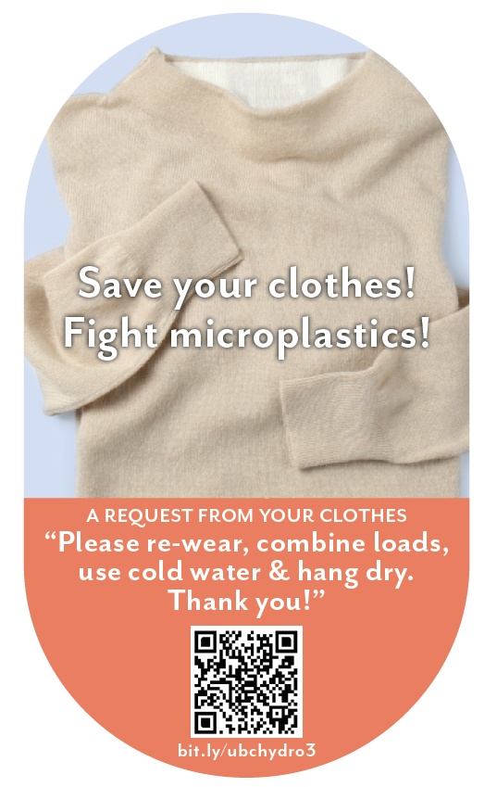
Clothing + Bundled
When you machine wash and dry your clothes with hot water and hot air, “microplastics” come out of your clothes. In fact, experts say that between 700,000 and 12 million microfibres can be shed during one single load of laundry. This breaks down the fabric in your clothes, damaging it and shortening the amount of time you’ll be able to enjoy wearing it.
You can save your clothes by:
- Re-wearing clothes more often
- Combining loads to, run fewer, larger loads of laundry
- Washing laundry with cold water, rather than hot water or warm water
- Hanging clothes to dry (inside or outside), rather than machine-drying clothes
As part of your participation in this study, we will mail you a decal to put on your washer or dryer, which will look like the following:

Slide 14
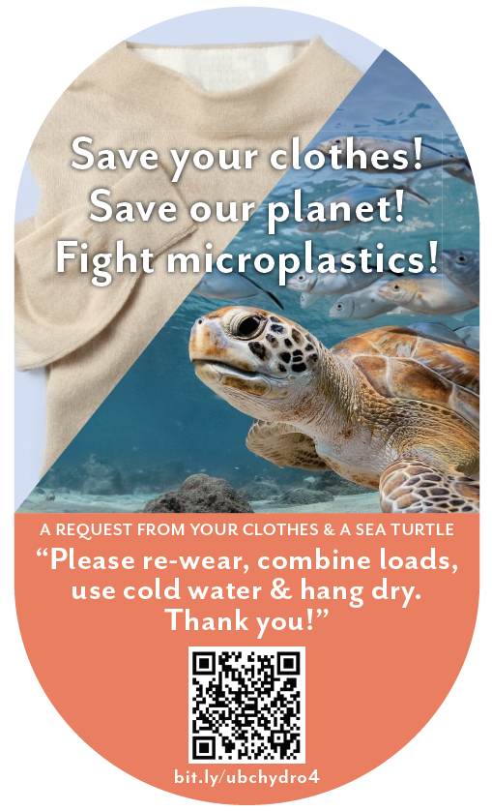
Turtle + Clothing + Bundled
When you machine wash and dry your clothes with hot water and hot air, “microplastics” come out of your clothes. In fact, experts say that between 700,000 and 12 million microfibres can be shed during one single load of laundry. This breaks down the fabric in your clothes, damaging it and shortening the amount of time you’ll be able to enjoy wearing it. It is also estimated that laundry is responsible for 35% of microplastics in our oceans, seriously harming sea turtles and other marine life.
You can save your clothes and save our planet by:
- Re-wearing clothes more often
- Combining loads to, run fewer, larger loads of laundry
- Washing laundry with cold water, rather than hot water or warm water
- Hanging clothes to dry (inside or outside), rather than machine-drying clothes
As part of your participation in this study, we will mail you a decal to put on your washer or dryer, which will look like the following:

Slide 15
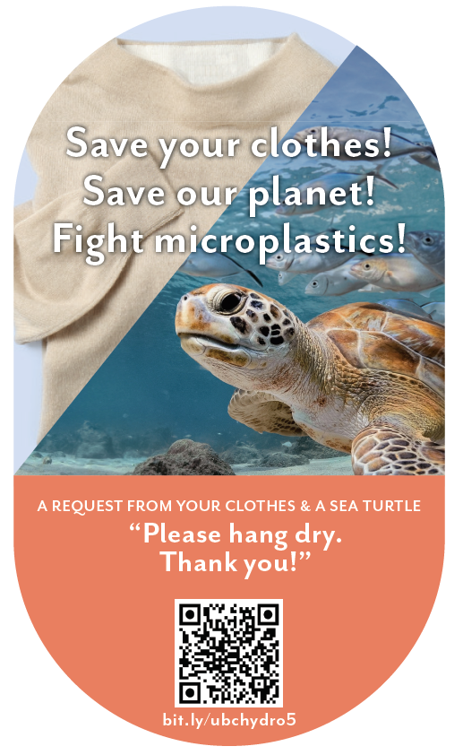
Turtle + Clothing + Hang Dry
When you machine wash and dry your clothes with hot water and hot air, “microplastics” come out of your clothes. In fact, experts say that between 700,000 and 12 million microfibres can be shed during one single load of laundry. This breaks down the fabric in your clothes, damaging it and shortening the amount of time you’ll be able to enjoy wearing it. It is also estimated that laundry is responsible for 35% of microplastics in our oceans, seriously harming sea turtles and other marine life.
You can save your clothes and save our planet by:
- Hanging clothes to dry (inside or outside), rather than machine-drying clothes
As part of your participation in this study, we will mail you a decal to put on your washer or dryer, which will look like the following:

Slide 16
Results

Slide 17
Intentions to engage in efficient laundry behaviours
Label | Cold Water | Rewear | Combine Load | Hang Dry | Average
Control (n=217) | 3.35 | 3.24 | 3.27 | 3.53 | 3.34
QR Scan Only Control (n=185) | 3.25 | 3.10 | 3.19 | 3.44 | 3.25
Sea turtle + bundled msg (n=189) | 3.61₁ ₂ | 3.47₁ ₂ | 3.46₁ ₂ | 3.60 | 3.53₁ ₂
Fleece + bundled msg (n=200) | 3.58₁ ₂ | 3.52₁ ₂ | 3.48₁ ₂ | 3.61₂ | 3.55₁ ₂
Sea turtle + fleece + bundled msg (n=184) | 3.60₁ ₂ | 3.42₁ ₂ | 3.40₁ ₂ | 3.54 | 3.49₁ ₂
Sea turtle + fleece + hang dry msg (n=189) | 3.56₁ ₂ | 3.42₁ ₂ | 3.38₂ | 3.77₁ ₂ | 3.53₁ ₂
Note: Participants answered on a 1-5 scale from 1=“much less often” to 3=“the same” to 5=“much more often”.
Subscripts indicate significant difference from control (1) or QR scan only control (2).

Slide 18
Intentions to engage in efficient laundry behaviours
Label | Cold Water | Rewear | Combine Load | Hang Dry | Average
Control (n=217) | 3.35 | 3.24 | 3.27 | 3.53 | 3.34
QR Scan Only Control (n=185) | 3.25 | 3.10 | 3.19 | 3.44 | 3.25
Sea turtle + bundled msg (n=189) | 3.61₁ ₂ | 3.47₁ ₂ | 3.46₁ ₂ | 3.60 | 3.53₁ ₂
Fleece + bundled msg (n=200) | 3.58₁ ₂ | 3.52₁ ₂ | 3.48₁ ₂ | 3.61₂ | 3.55₁ ₂
Sea turtle + fleece + bundled msg (n=184) | 3.60₁ ₂ | 3.42₁ ₂ | 3.40₁ ₂ | 3.54 | 3.49₁ ₂
Sea turtle + fleece + hang dry msg (n=189) | 3.56₁ ₂ | 3.42₁ ₂ | 3.38₂ | 3.77₁ ₂ | 3.53₁ ₂
Note: Participants answered on a 1-5 scale from 1=“much less often” to 3=“the same” to 5=“much more often”.
Subscripts indicate significant difference from control (1) or QR scan only control (2).

Slide 19

Intentions to engage in efficient laundry behaviours
Summary:
All decals increased intentions to improve behaviours
Roughly equally effective on intentions

Slide 20
Retrospective Self-reports
Takeaway:
From S1 to S4, participants were marginally less likely to report engaging in laundry efficient behaviours for the control conditions (ps <.1). “Sea turtle+fleece+hang dry” message and “Sea turtle+bundled” message were marginally more effective than control conditions at S4 (ps <.1)

Slide 21
Retrospective Self-reports
Takeaway:
From S1 to S4, participants were marginally less likely to report engaging in laundry efficient behaviours for the control conditions (ps <.1). “Sea turtle+fleece+hang dry” message and “Sea turtle+bundled” message were marginally more effective than control conditions at S4 (ps <.1)

Slide 22
Retrospective Self-reports
Summary:
Two decal messages marginally improved self-reported behaviours:
Microplastics turtle + bundled msg
Microplastics turtle + fleece+hang-dry msg

Slide 23
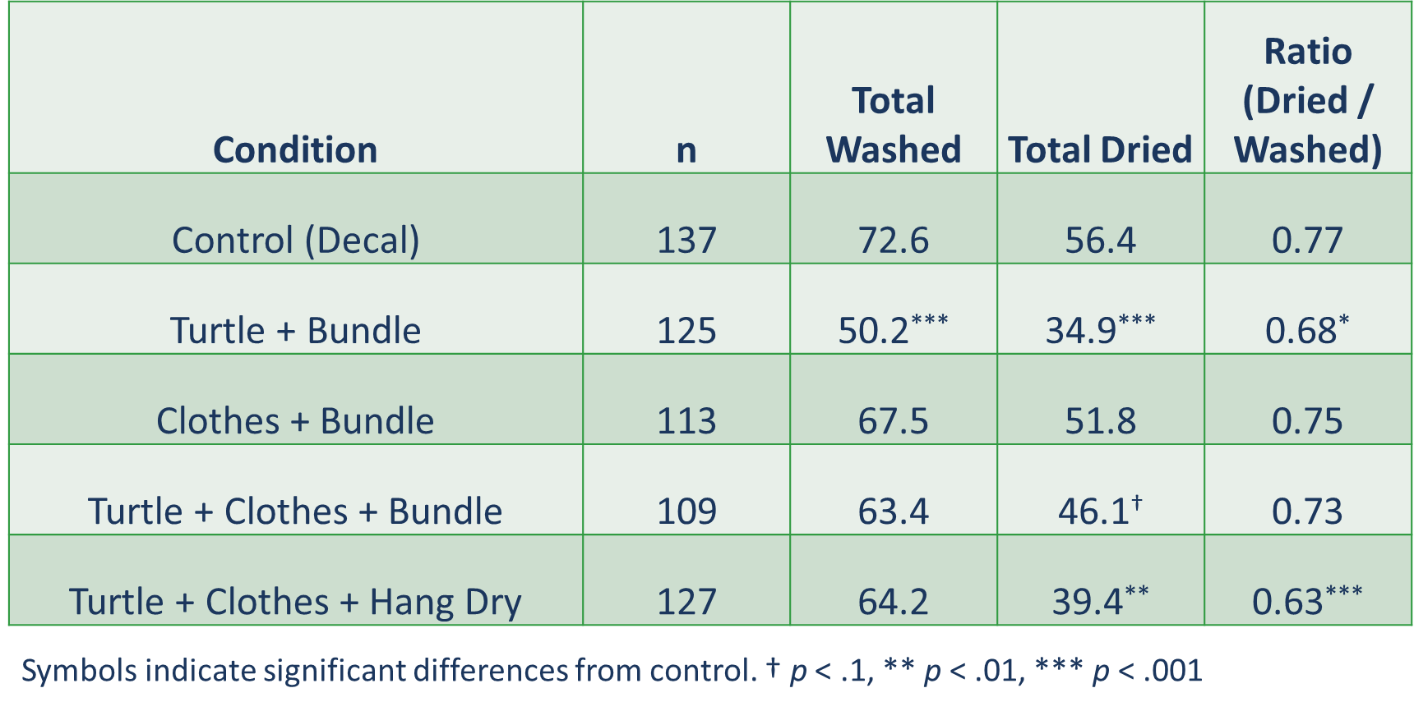
Behaviour Logging
Notes:
These are the total numbers reported across the year. However, we only made logging “mandatory” for the first six months. Furthermore, man loads may not have been logged. The average across the year comes out to 1.2 laundry loads logged per week, and 0.9 drier loads logged per week. This is far below BC Hydro’s Residential End Use Study, which indicates the average # of washer loads (across all households and housing types) is 3.7 per week and the average # of dryer loads is 3.5 per week. The difference is likely due to a combination of self-selection and self-report issues. The ratio of machine dried loads to washed loads is probably the most reliable measure, avoiding self-report effects (but not self-selection effects).

Slide 24
Behaviour Logging
Summary:
Two decal messages improved logged behaviours over time:
Microplastics turtle + bundled msg decreased washing and drying
Microplastics turtle + fleece+hang-dry msg decreased drying

Slide 25
Energy Meter Results: kWh per Day across all participants
Condition | Pre | Post | Change
Control (No survey) | 22.74 | 23.36 | 0.62
Control (No decal) | 21.21 | 21.54 | 0.32
Control (QR decal) | 22.93 | 23.14 | 0.21
Turtle + Bundle Msg | 23.02 | 23.79 | 0.77
Fleece + Bundle Msg | 22.04 | 22.77 | 0.72
Turtle + Fleece + Bundle Msg | 21.26 | 22.16 | 0.9
Turtle + Fleece + Hang Dry Msg | 22.06 | 22.54 | 0.48
NOTE: No significant differences across conditions

Slide 26
Energy Meter Results: kWh for logging participants
Condition | n | Total Energy | Wash Energy | Dry Energy | Dry Ratio
Control (Decal only) | 94 | 15,168 | 139 | 121 | 0.81
Turtle + Bundle Msg | 91 | 14,704 | 105† | 79* | 0.68**
Fleece + Bundle Msg | 98 | 15,778 | 141 | 121 | 0.8
Turtle + Fleece + Bundle Msg | 72* | 14,240 | 102† | 82* | 0.79
Turtle + Fleece + Hang Dry Msg | 92 | 14,410 | 122 | 86* | 0.69**
Symbols indicate significant differences from control. † p < .1, * p < .05, ** p < .01

Slide 27
Metered efficient laundry behaviours
No significant change in total energy usage, but when isolating laundry times, three condition were effective:
Turtle + bundled msg
Turtle + fleece + bundled msg
Turtle + fleece + hang dry

Slide 28
Summary & Conclusions

Slide 29
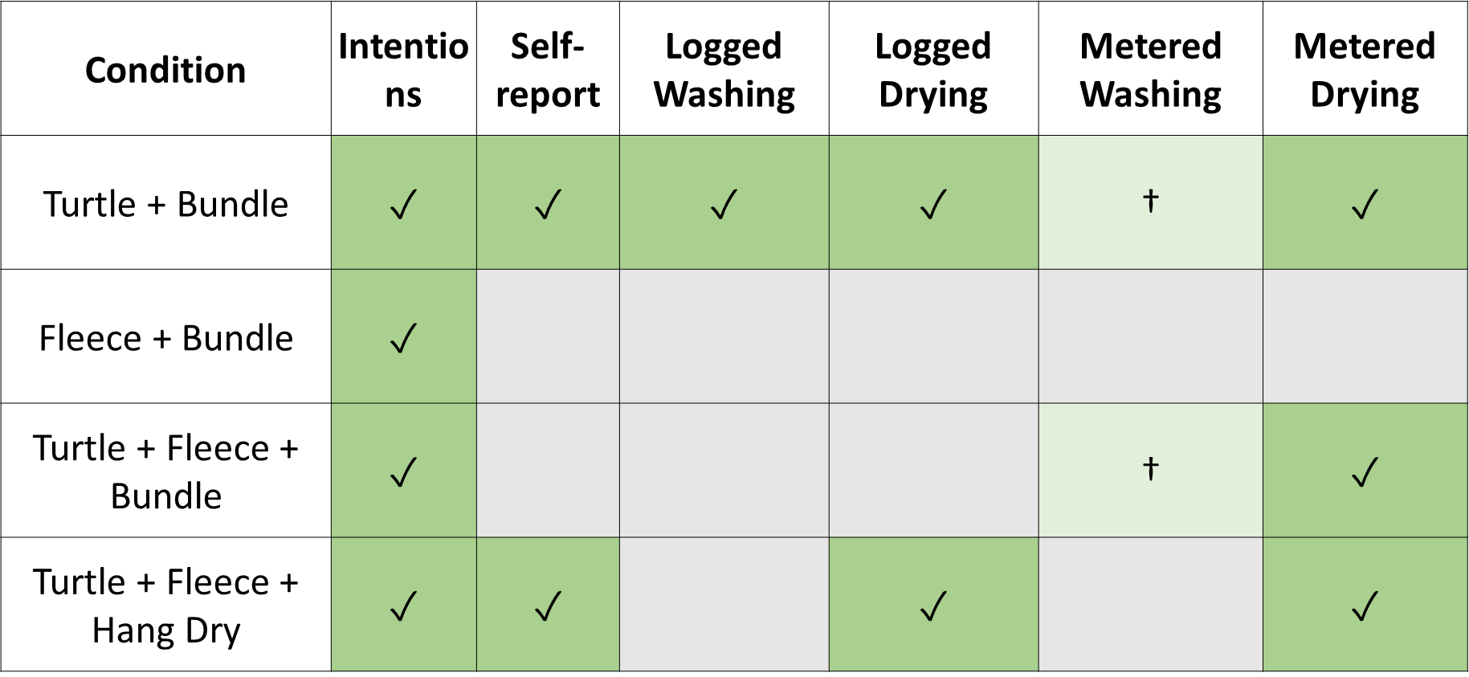
Summary: Decal Effectiveness vs Control

Slide 30
Conclusions
In the context of a motivated sample of BC laundry doers, over a period of one year:
Decals can be an effective nudging tool for sustaining energy efficient behaviour over time; serves as a constant reminder & motivation; attractive image is important; could be extended to other behaviours
Intentions are not a reliable guide to real environmental behaviour
Changes in laundry behaviours were not detectable in total household energy usage

Slide 31
Conclusions
Most effective: combining a single, novel motivator (microplastics turtle) with multiple behaviour change requests
Not so effective in this context: financial information, climate information
Sometimes energy motivations are not the best way to change energy behaviours!
Not all environmental motivators are the same

Slide 32
Thank you!
Contact: david.hardisty@sauder.ubc.ca

